Slide 1










Data Mart
ANALYSIS
Presented by
Simala Om Prakash
Data Analyst

Slide 2




Introduction
Data Mart Sales Performance Analysis
Welcome to the presentation on analyzing the sales and performance of Data Mart.
We'll delve into the impact of sustainable packaging methods implemented in June 2020.
Let's explore the trends and insights derived from the data.

Slide 3



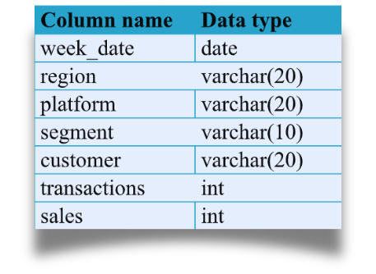
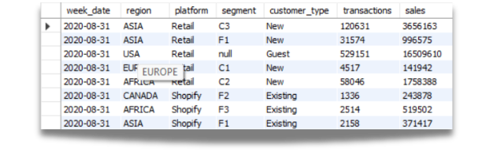
SCHEMA USED: WEEKLY_SALES TABLE

Slide 4
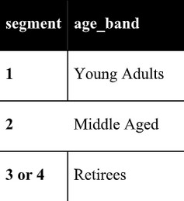

Data Cleansing Steps
In a single query, perform the following operations and generate a new table in
the data_mart schema named clean_weekly_sales:
1. Add a week_number as the second column for each week_date value, for
example any value from the 1st of January to 7th of January will be 1, 8th to
14th will be 2, etc.
2. Add a month_number with the calendar month for each week_date value as
the 3rd column
3. Add a calendar_year column as the 4th column containing either 2018, 2019
or 2020 values
4. Add a new column called age_band after the original segment column using
the following mapping on the number inside the segment value
5. Add a new demographic column using the following mapping for the first
letter in the segment values:
segment | demographic |
C | Couples |
F | Families |
6. Ensure all null string values with an &quot;unknown&quot; string value in the
original segment column as well as the
new age_band and demographic columns
7. Generate a new avg_transaction column as the sales value divided
by transactions rounded to 2 decimal places for each record

Slide 5


PROJECT QUESTIONS
1. Which week numbers are missing from the dataset?
2. How many total transactions were there for each year in the dataset?
3. What are the total sales for each region for each month?
4. What is the total count of transactions for each platform
5. What is the percentage of sales for Retail vs Shopify for each month?
6. What is the percentage of sales by demographic for each year in the dataset?
7. Which age_band and demographic values contribute the most to Retail
sales?

Slide 6




Data Cleansing Steps
In this first step, I cleaned the data to ensure accuracy and consistency.
Operations included adding week and month numbers, categorizing age bands and demographics, and handling null values.
A new table named 'clean_weekly_sales' was created in the data_mart schema.
create table clean_weekly_sales as
select week_date,
week(week_date) as week_number,
month(week_date) as month_number,
year(week_date) as calendar_year,
region,platform,
case
when segment is null then 'Unknown'
else segment
end as segment,
case
when right(segment,1)='1' then 'Young Age'
when right(segment,1)='2' then 'Middle Age'
when right(segment,1) in ('3','4') then 'Retirees'
else 'Unknown'
end as age_band,
case
when left(segment,1)='C' then 'Couples'
when left(segment,1)='F' then 'Families'
else 'Unknown'
end as demographic,
customer_type,transactions,sales,
round(sales/transactions,2) as 'avg_sales'
from weekly_sales

Slide 7


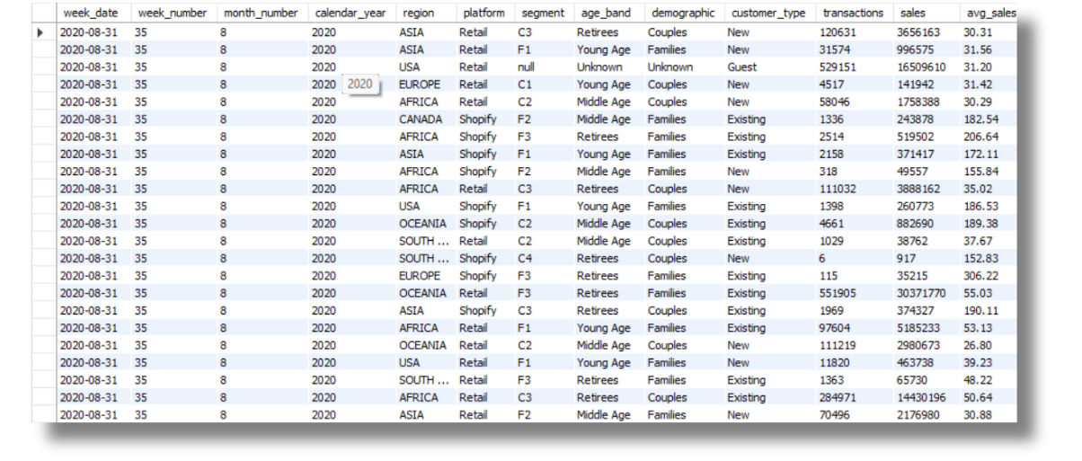

New Table

Slide 8

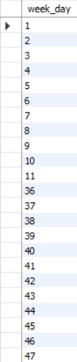

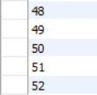
Q1. Missing Week Numbers
create table seq100
(x int not null auto_increment primary key);
insert into seq100 values (),(),(),(),(),(),(),(),(),();
insert into seq100 values (),(),(),(),(),(),(),(),(),();
insert into seq100 values (),(),(),(),(),(),(),(),(),();
insert into seq100 values (),(),(),(),(),(),(),(),(),();
insert into seq100 values (),(),(),(),(),(),(),(),(),();
insert into seq100 select x + 50 from seq100;
select * from seq100;
create table seq52 as (select x from seq100 limit 52);
select distinct x as week_day
from seq52 where x not in(
select distinct week_number from clean_weekly_sales);

Slide 9
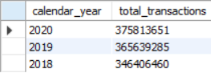
Q2. Total Transactions by Year
SELECT
calendar_year,
SUM(transactions) AS total_transactions
FROM clean_weekly_sales group by calendar_year;
Analyzing the total transactions per year revealed trends in sales volume over time.
This insight aids in understanding overall business performance and growth.

Slide 10
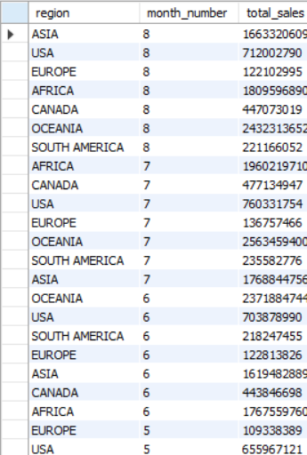
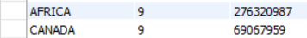
Q3. Total Sales by Region and Month
select region,month_number,sum(sales) as total_sales
from clean_weekly_sales
group by region,month_number
Total sales were analyzed by region and month.
This breakdown provides valuable insights into regional performance and seasonal variations.

Slide 11
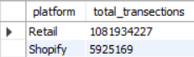
Q4. Transactions by Platform
select platform,sum(transactions) as total_transections
from clean_weekly_sales
group by platform
We examined the total count of transactions for each platform.
This analysis helps in understanding customer preferences and platform effectiveness.

Slide 12
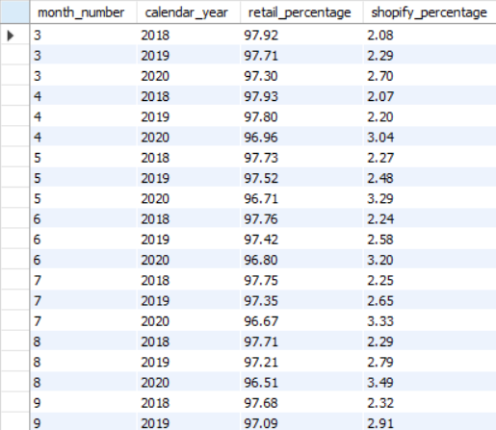
Q5. Retail vs. Shopify Sales
WITH cte_monthly_platform_sales AS (
SELECT
month_number,calendar_year,
platform,
SUM(sales) AS monthly_sales
FROM clean_weekly_sales
GROUP BY month_number,calendar_year, platform
)
SELECT
month_number,calendar_year,
ROUND(
100 * MAX(CASE WHEN platform = 'Retail' THEN monthly_sales ELSE NULL END) /
SUM(monthly_sales),
2
) AS retail_percentage,
ROUND(
100 * MAX(CASE WHEN platform = 'Shopify' THEN monthly_sales ELSE NULL END) /
SUM(monthly_sales),
2
) AS shopify_percentage
FROM cte_monthly_platform_sales
GROUP BY month_number,calendar_year
ORDER BY month_number,calendar_year;
Percentage analysis of sales for Retail vs. Shopify was conducted for each month.
This comparison highlights the distribution of sales across different platforms.

Slide 13
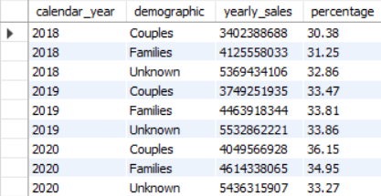
Q6. Sales by Demographic
SELECT
calendar_year,
demographic,
SUM(SALES) AS yearly_sales,
ROUND(
(
100 * SUM(sales)/
SUM(SUM(SALES)) OVER (PARTITION BY demographic)
),
2
) AS percentage
FROM clean_weekly_sales
GROUP BY
calendar_year,
demographic
ORDER BY
calendar_year,
demographic;
Sales percentage by demographic for each year was analyzed.
Understanding demographic preferences can inform marketing strategies and product targeting.

Slide 14
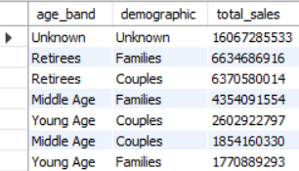
Q7. Top Contributors to Retail Sales
SELECT
age_band,
demographic,
SUM(sales) AS total_sales
FROM clean_weekly_sales
WHERE platform = 'Retail'
GROUP BY age_band, demographic
ORDER BY total_sales DESC;
Identified top age bands and demographics contributing to Retail sales.
This insight helps in optimizing marketing efforts and tailoring product offerings.

Slide 15


Conclusion
The analysis provided valuable insights into Data Mart's sales performance.
Recommendations based on findings can guide future strategies and initiatives.
Continuous monitoring and analysis are crucial for maintaining competitive advantage.

Slide 16



Thanks!
@Simala Om Prakash

